Slide 1
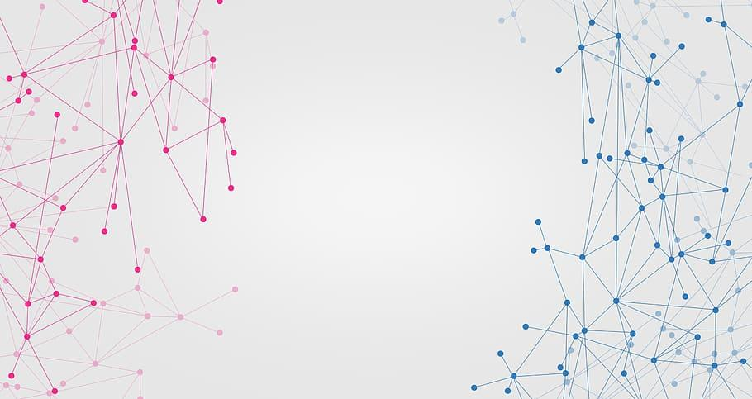
Security Mechanisms in Practice
CS 212 Presentation
Team Members:
Maanas Bhaya
Ch. Bharadwaj
B. Harshavardhan Reddy
P. Mithun

Slide 2


Slide 3
Basic Understanding of SSL

Slide 4

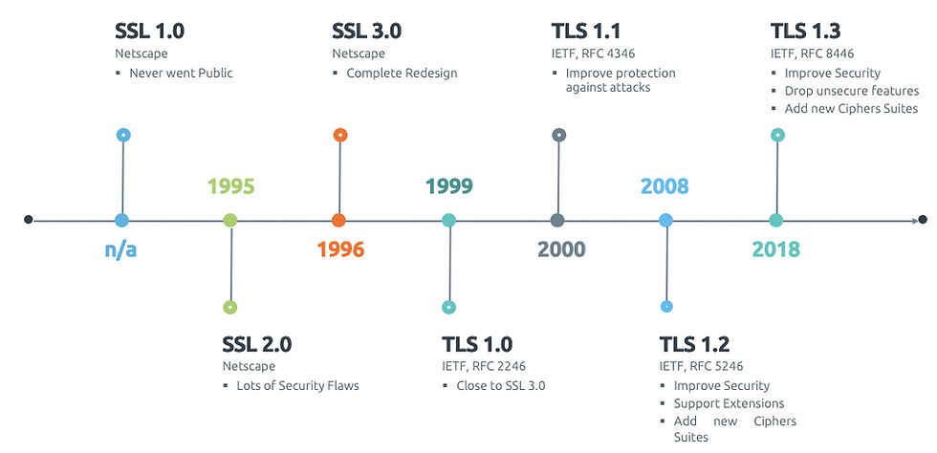
History of SSL
Image source: NetworkDataPedia

Slide 5

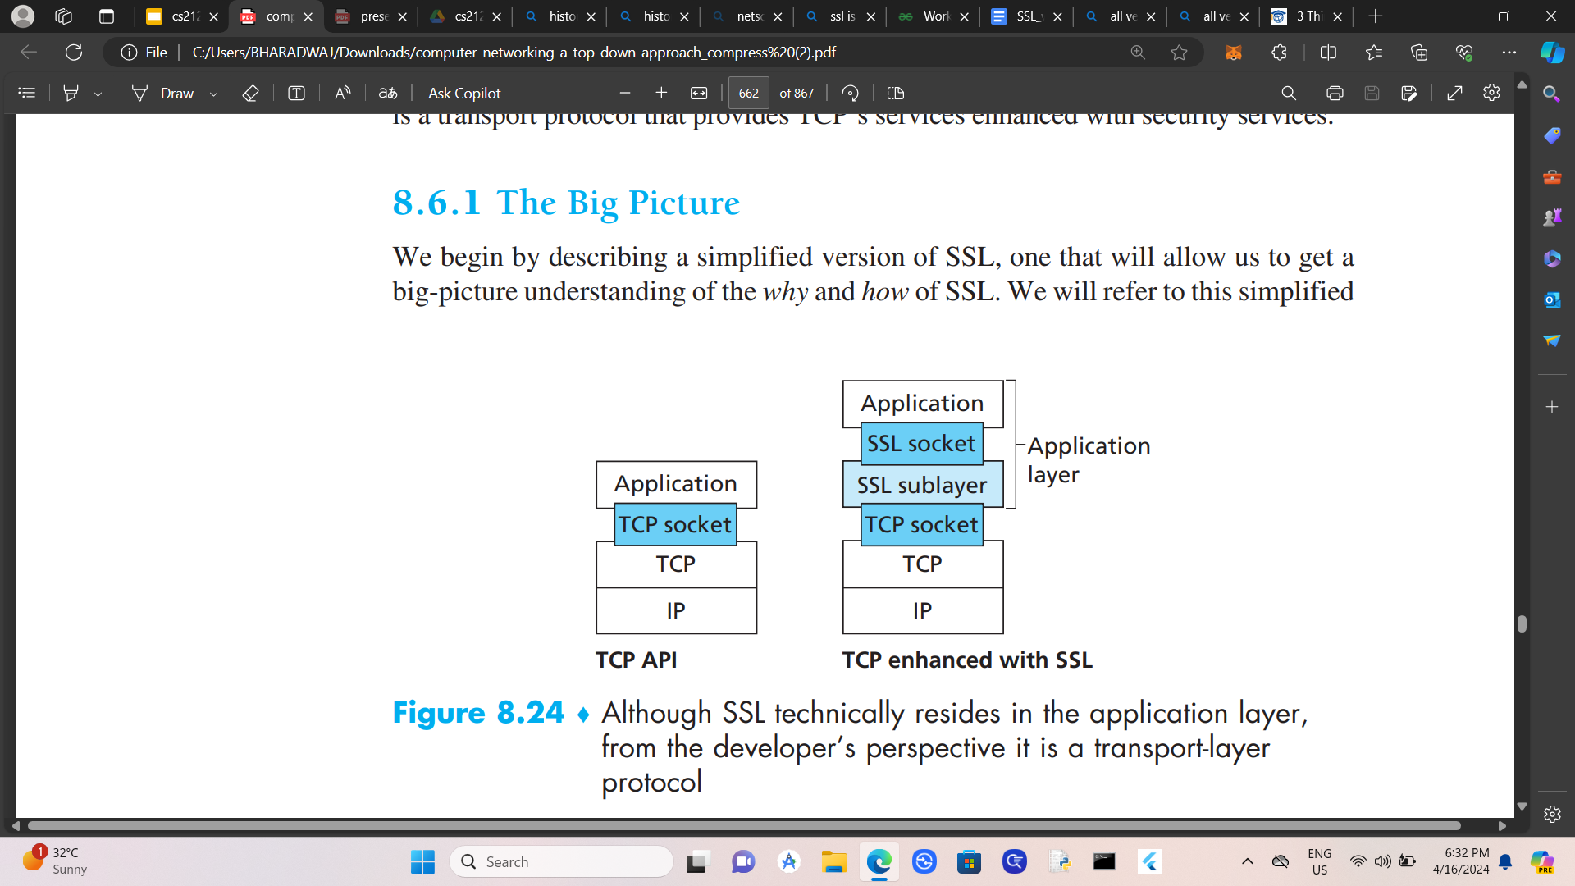
History of SSL
The enhanced version of TCP ,with security services, including confidentiality/privacy, authentication, and data integrity, is commonly known as Secure Sockets Layer (SSL).
It was first developed by Netscape in 1995 for the purpose of ensuring confidentiality/privacy, authentication, and data integrity in Internet communications.
SSL eventually evolved into TLS (Transport Layer Security).
Image source: SSL Dragon, kurose book

Slide 6

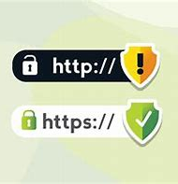
What is SSL?
SSL is, an encryption-based Internet security protocol, a two-layered protocol that sits between the Application layer and the Transport layer of the OSI model.
It provides security to the data that is transferred between web browser and server.
A website that implements SSL/TLS has "HTTPS" in its URL instead of "HTTP."
Image source: Internet Explorer

Slide 7
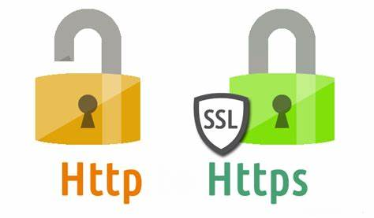
http vs https
The S in "HTTPS" stands for "secure." HTTPS is just HTTP with SSL/TLS.
A website with an HTTPS address has a legitimate SSL certificate issued by a certificate authority
Traffic to and from that website is authenticated and encrypted with the SSL/TLS protocol.

Slide 8


Difference between http and https
http
https

Slide 9
Secure Sockets Layer
Components of SSL
It is located between application layer and Network layer.(socket)
Key, Encryption, Decryption
Cryptography etc….
Confidentiality
Data Integrity
Authentication

Slide 10
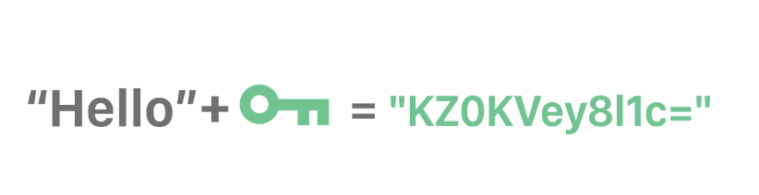
What is a key?
A key is a group of random characters in a particular order. Encryption protocols use a key to alter data so that it's scrambled, and so that anyone without the key can't decode the information.
There are mainly two different types of keys. They are
Public Key
Private key

Slide 11
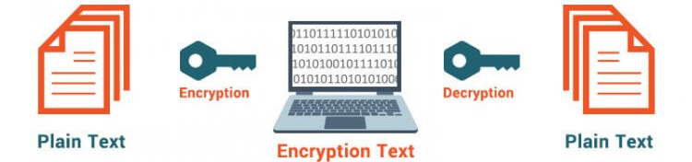
Encryption vs Decryption
Encryption is the method by which information is converted into secret code that hides the information's true meaning.
Decryption is the process of converting meaningless message (Ciphertext) into its original form (Plaintext).

Slide 12
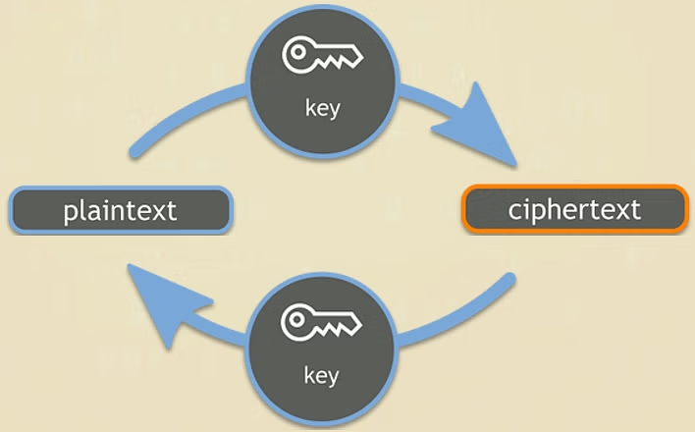
Ensuring confidentiality
CRYPTOGRAPHY
The prefix “crypt” means “hidden” and suffix “graphy” means “writing”.
The process of pair of encryption and decryption is called as cryptography.

Slide 13

Ensuring Authentication
Certifications, Cryptography
Cryptography is used for authentication in many different situations, such as when accessing a bank account, logging into a computer, or using a secure network.
Cryptographic methods are employed by authentication protocols to confirm the user’s identity and confirm that they have the required access rights to the resource.

Slide 14
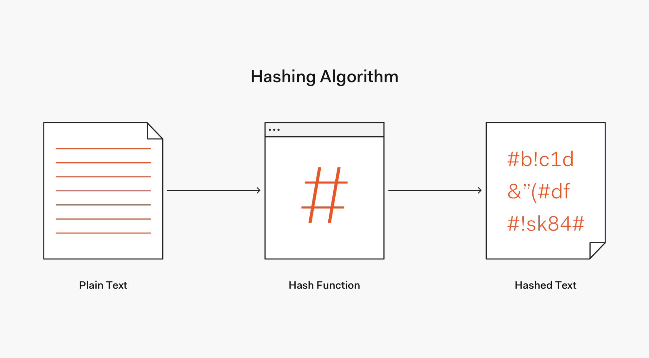
Ensuring Data Integrity
Cryptographic Hash Functions
There is no usage of any key in this algorithm.
Impossible to get plain text from hashed text
Many operating systems use hash functions to encrypt passwords.
Ex: Secure Hash Algorithm 1 (SHA-1) 1995, 160 bits.
Whirlpool( 2000) 512 bits.

Slide 15
How SSL Works

Slide 16
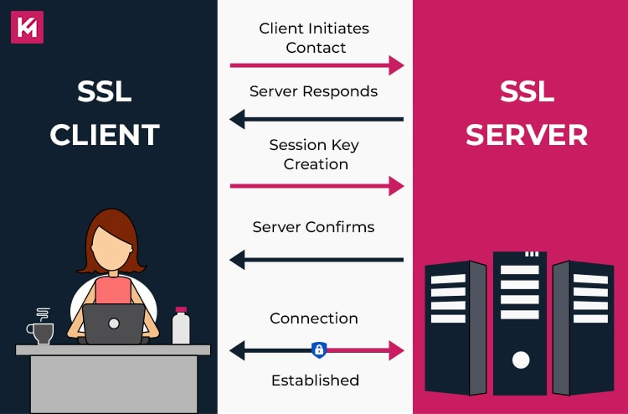
How SSL works?
Before learning about how SSL works, first, we need to understand the following two concepts:
(1)Asymmetric Cryptography
(2) Symmetric Cryptography

Slide 17
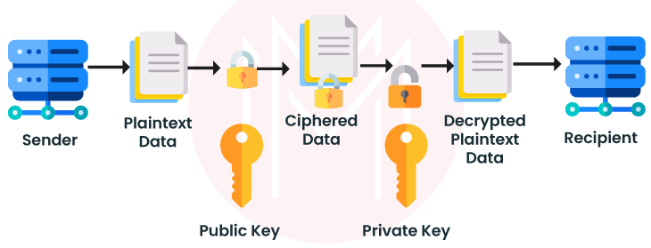
Asymmetric Cryptography , also known as Public Key Cryptography, involves using a pair of keys: a public key and a private key. The public key is shared openly for communication, while the private key is kept secure on the server.

Slide 18
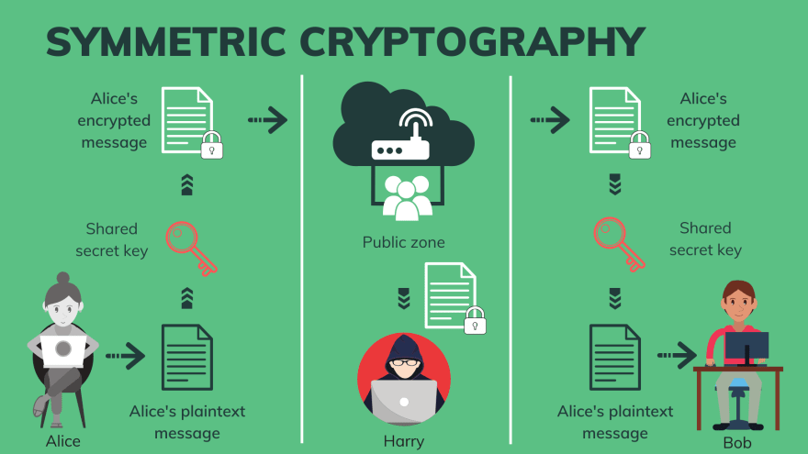
Symmetric cryptography:
Symmetric cryptography, also known as secret-key cryptography, is a method of encryption that uses the same secret key for both encryption and decryption. This means that both the sender and the receiver must have the same secret key to securely communicate with each other. The key must be kept secret and shared over a secure channel to maintain confidentiality

Slide 19
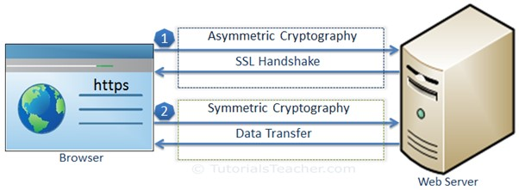
SSL data processing:
SSL uses both Asymmetric and Symmetric for encrypting data, the communication between two systems using SSL will have two steps as follows: SSL handshake and Data Transfer.

Slide 20
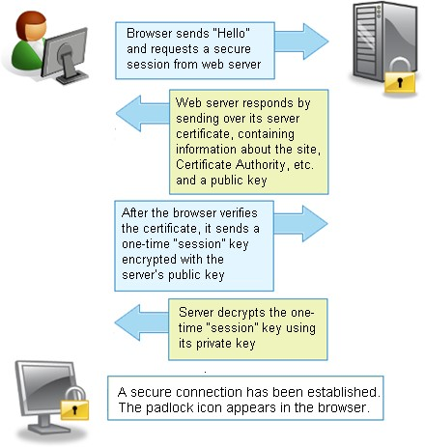
SSL Handshake
We will take the example of communication between a browser and a web server.
At the end of the SSL handshake process, both the browser and the server have a Session Key, this is the Key that will be used to encrypt and decrypt data during the communication of the two systems later.

Slide 21
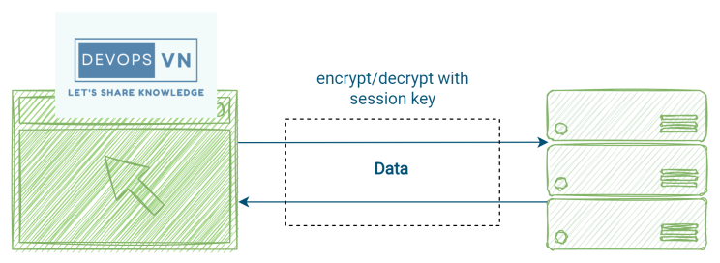
Data Transfer
This is the process of transferring data between two systems, Symmetric Cryptography will be used in this step, and both use Session Key to encrypt and decrypt data

Slide 22
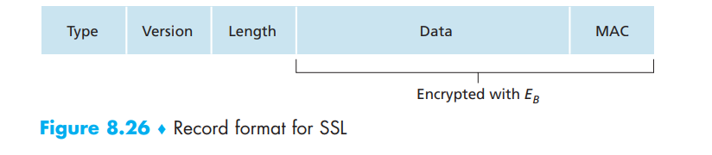
SSL Record
The SSL record consists of a type field, version field, length field, data field, and MAC(Message Authentication Code) field. The type field indicates whether the record is a handshake message or a message that contains application data. It is also used to close the SSL connection, as discussed below. SSL at the receiving end uses the length field to extract the SSL records out of the incoming TCP byte stream. The version field is self-explanatory.

Slide 23
Security in WLANs

Slide 24
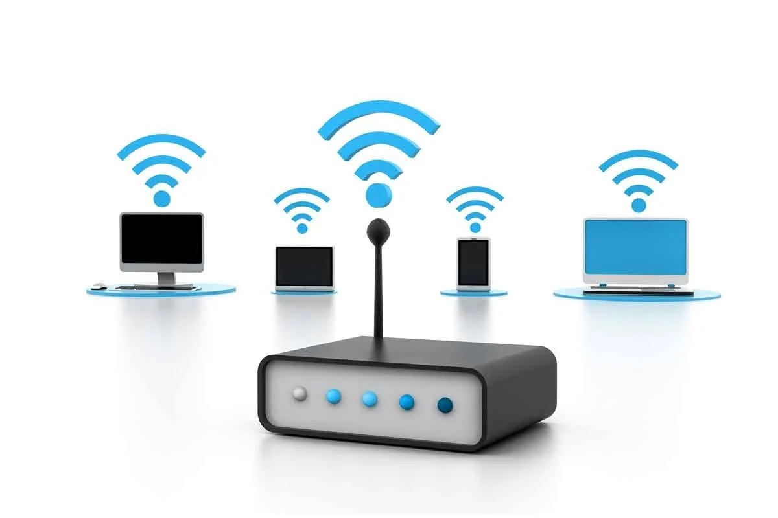
Image source: Hummingbird networks

Slide 25


The main players:
Image source: Wikipedia, IEEE

Slide 26
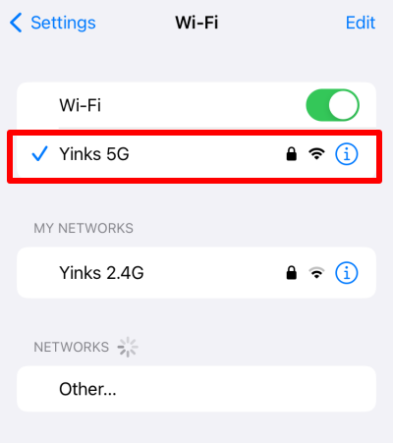
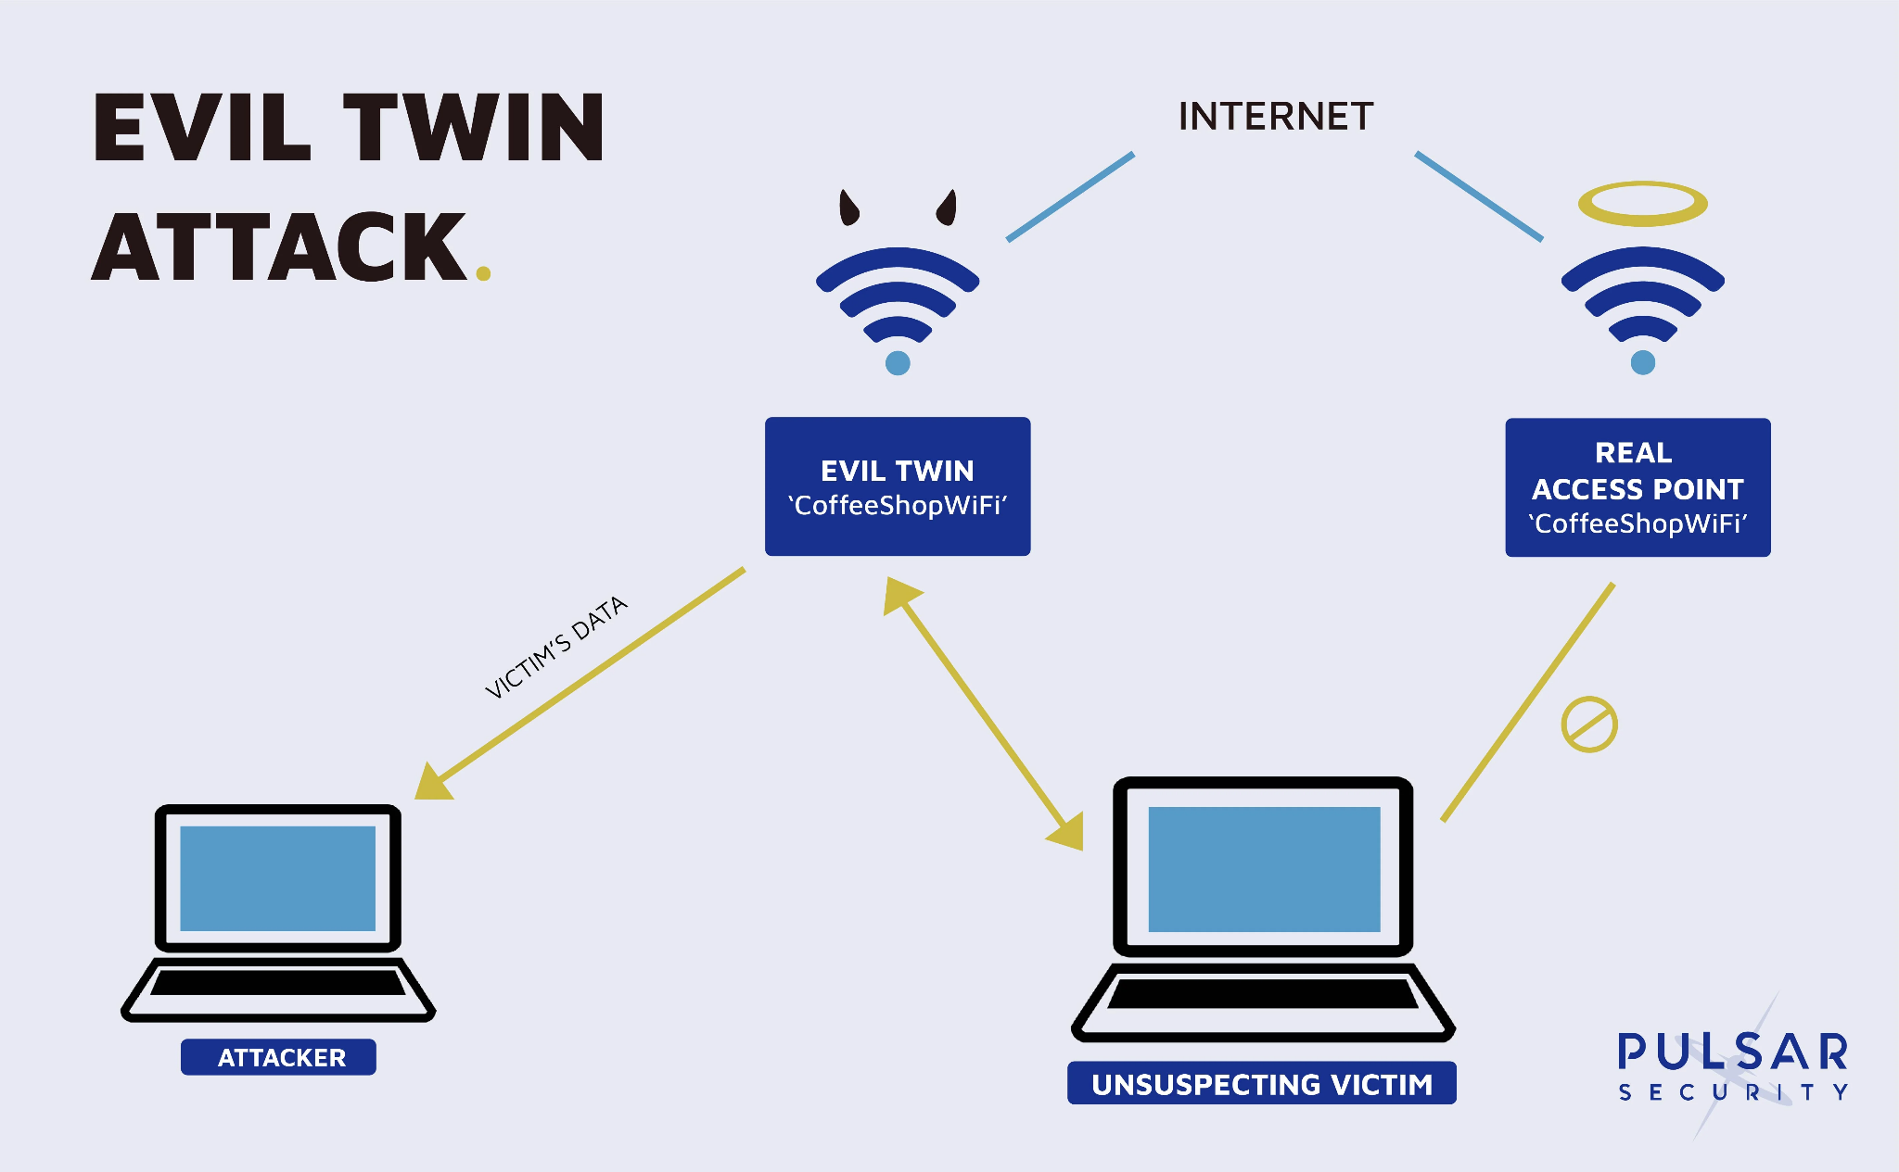
An example:
Image source: Wikipedia, Proton VPN

Slide 27
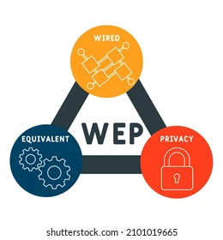
It all started with this - WEP
Image source: Shutterstock

Slide 28
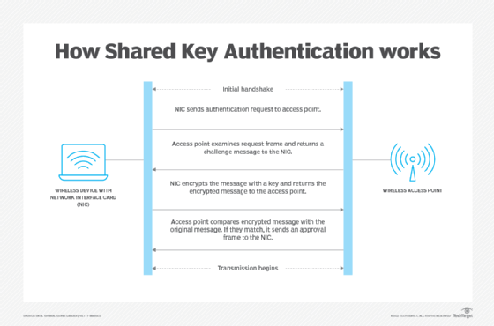
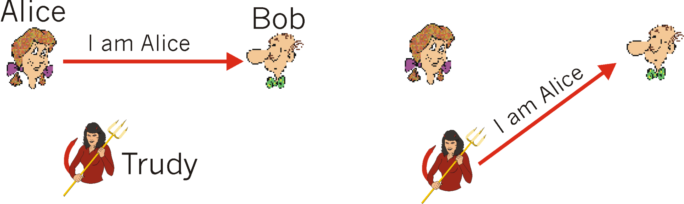
Authenticating: A practical example
Image source: TechTarget, University of Maryland

Slide 29
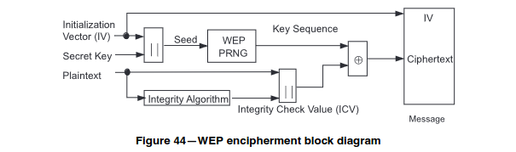

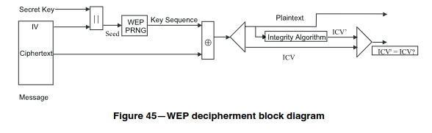
Wi-Fi Security: WEP - Encryption
Image source: Logsign, IEEE

Slide 30

Is WEP really that secure?
Image source: SD computer

Slide 31

Wi-Fi Protected Access - A temporary successor
Image source: Panda Security

Slide 32

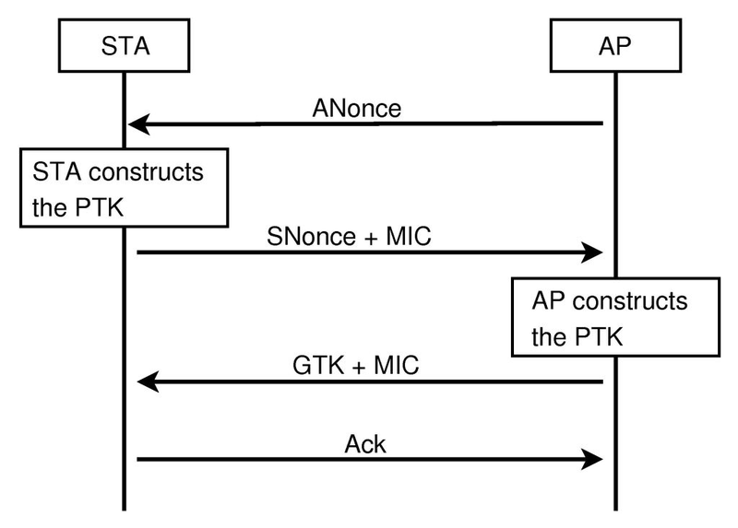
Wi-Fi Protected Access 2 (WPA2)
Image source: Panda Security, Wikipedia

Slide 33
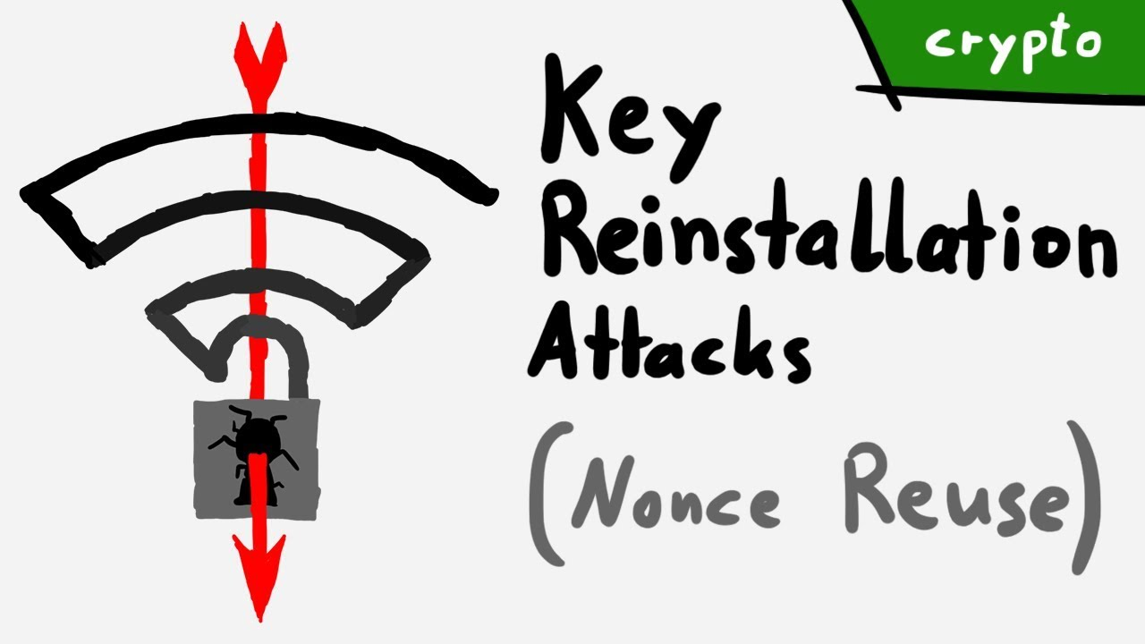
Wi-Fi Protected Access 2 (WPA2) - Flaws
Image source: LiveOverflow

Slide 34

Wi-Fi Protected Access 3 (WPA3)
In 2018, the Wi-Fi alliance announced WPA3 as the successor to WPA2.
Essential features are maintained, improvements are made on those features.
Simultaneous Authentication of Equals (SAE) is a key feature of WPA3.
WPA3 has three main modes of operation: WPA3 Personal, WPA3 Enterprise and Wi-Fi Enhanced Open
Image source: Wikipedia

Slide 35
Wi-Fi Protected Access 3 (WPA3) - Modes
WPA3 Personal: focuses on improving security for individual users using the SAE. Allows users to maintain easy to remember passwords with less risk of intrusion.
WPA3 Enterprise: Built on top of WPA2 Enterprise, and requires the use of Protected Management Frames
Wi-Fi Enhanced Open: Increases Privacy in Open networks. Prevents passive eavesdropping on open networks even if no password is used.
Image source: Wiki

Slide 36
The Firewall

Slide 37
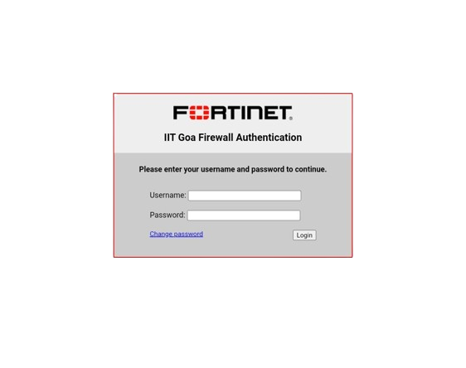
Something we see daily!

Slide 38
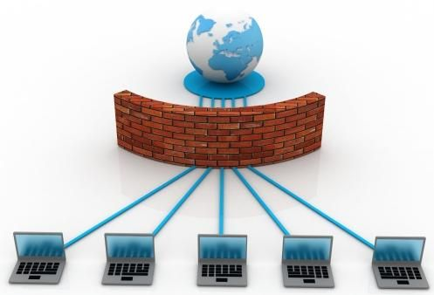
What is Firewall?
A firewall around a computer or network is like the wall around a castle or city.
A firewall is a network security device that prevents unauthorized access to a network.

Slide 39

What is Firewall?
In real world, it is similar to a guard making decisions based on where a person is trying to go, where they came from, or both before admitting them.

Slide 40
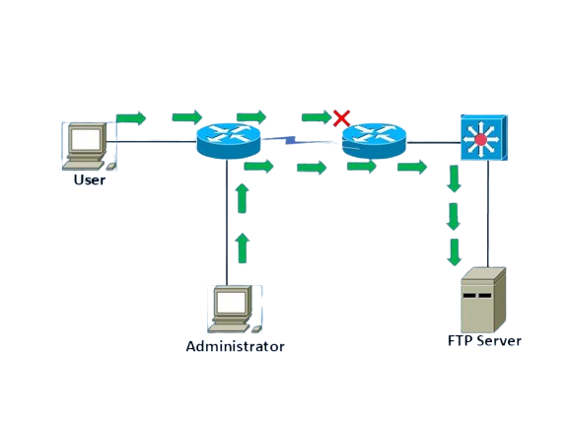
History
Access Control Lists (ACL):
ACLs are rules that determine whether network access should be granted or denied to specific IP address.
ACLs cannot determine the nature of packet it is blocking.
Also, it does not have the capacity to keep threats out of the network.
Image source: Networkeducator
That’s how Firewall came into the picture.
It was officially introduced in early 1990s.

Slide 41
How does it work?
Firewall match the network traffic against the rule set defined in its table.
Once the rule is matched, associate action is applied to the network traffic.
Network traffic can be either outgoing or incoming.
Firewall maintains a distinct set of rules for both the cases.
Rules can be defined on the firewall based on the necessity and security policies of the organization.
Default Policy: It is very difficult to explicitly cover every possible rule on the firewall. For this reason, the firewall must always have a default policy. Default policy only consists of action(accept, reject or drop). Setting default policy as drop(reject) is always a good practice as we don’t want to allow unwanted traffic.

Slide 42
TYPES OF FIREWALL
Packet Filtering
Web Application
Stateful Inspection
Firewall
Software
Hardware
Next Generation
Proxy Service
Circuit Level Gateway

Slide 43
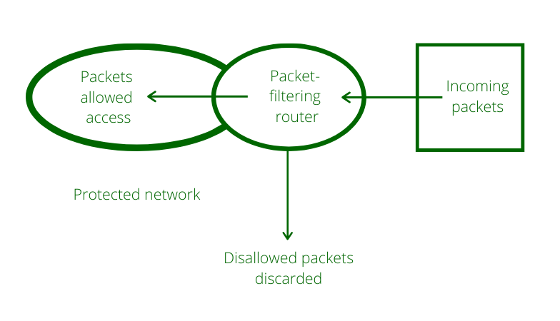
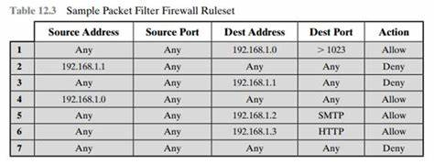
Packet Filtering Firewall
A packet filtering firewall selectively allows or denies network traffic based on predefined rules or criteria.
Packet filtering firewall maintains a filtering table that decides whether the packet will be forwarded or discarded.
Image source: GeeksForGeeks, Transtutors

Slide 44
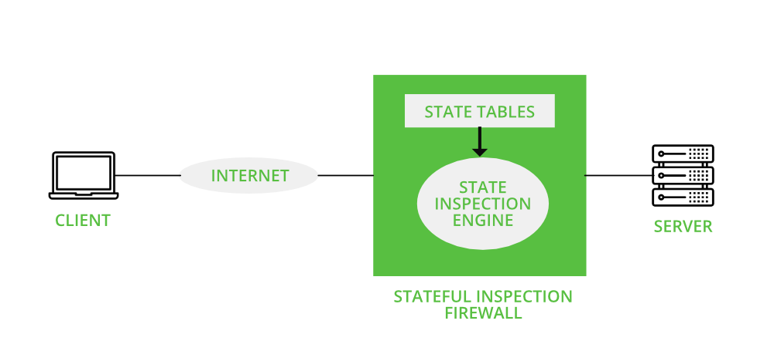
Stateful Inspection Firewall
A stateful inspection firewall monitors the state of active connections to make decisions on allowing or denying network traffic.
For example, the firewall captures the packet’s state and context information and compares it to the previous session data, if the entry exists it allows the packet. Otherwise, the packet goes through some policy checks to enter into the firewall.
Image source: GeeksForGeeks

Slide 45
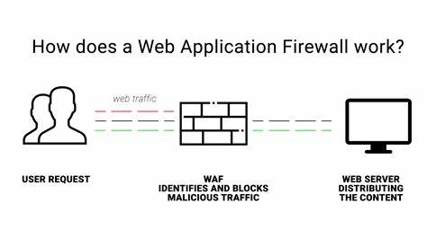
Web Application Firewall
Web Application Firewall is a protocol layer seven defence.
It monitors, filters and controls network traffic based on specific applications or protocols.
The clients are passed onto the WAF before reaching the server in order to prevent the server from any attacks.
Image source: Patchstack

Slide 46

Next Generation Firewall
The traditional firewall allows or restrict traffic according to the rules specified by the administrator.
Along with the traditional firewall capabilities, NGFW also provides advanced security features such as deep packet inspection, intrusion prevention offering etc… enhancing protection against modern threats.
Image source: GDT

Slide 47
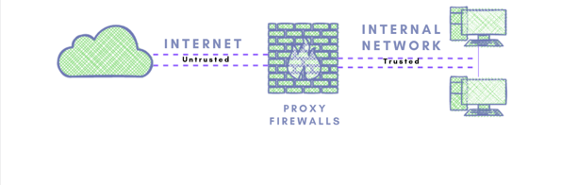
Proxy Service Firewall
The proxy service firewall acts as an intermediary between trusted internal network and outside internet.
If a computer inside an internal network needs to send a message to the outside network, it first communicates with proxy and proxy forwards the data from internal network to internet.
It is also known as application firewall.
Image source: Zenarmor
It has its own IP address so that the internal network is protected from making direct connections with the outside network.

Slide 48
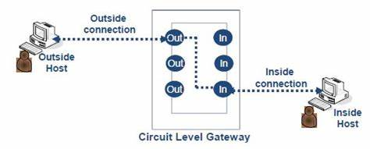
Circuit Level Gateway Firewall
Circuit-level gateway firewall operates at the session layer (Layer 5) of the OSI model.
The circuit level gateway can be done with the help of two TCP connections one with the inside host and the other with outside host.
After the connection establishment of inner and outside host, the gateway transmits the TCP segments from one to another without bothering about the content.
Image source: 2.bp.blogspot
It maintains the table that validates the connection and check of network packet that pass and the entry is removed when the firewall terminates the connection.

Slide 49
Advantages
Protection from unauthorized access.
Blocking the malware attacks at top level.
Monitoring of network activity.
Network segmentation.
Disadvantages
Complexity
Expensive
Can slow down computer performance.
Sometimes, they can also block legitimate traffic we need.

Slide 50
Source Links and Books
Computer Networks by Kurose
https://www.cloudflare.com/learning/ssl/what-is-ssl/
https://www.geeksforgeeks.org/introduction-of-firewall-in-computer-network/
https://www.bu.edu/tech/about/security-resources/host-based/intro/
https://www.linkedin.com/pulse/how-ssl-works-qu%C3%A2n-hu%E1%BB%B3nh
https://www.infosec.gov.hk/en/best-practices/business/wireless-network-security
https://en.wikipedia.org/wiki/IEEE_802.11i-2004
https://en.wikipedia.org/wiki/Wi-Fi_Protected_Access
https://www.netspotapp.com/blog/wifi-security/what-is-wpa3.html

Slide 51

Conclusion: En Garde!

Slide 52
